Slide 1
Sequence Generation

Slide 2
Outline
RNN with Gated Mechanism
Sequence Generation
Conditional Sequence Generation

Slide 3
RNN with Gated Mechanism
Notes:
http://www.thespermwhale.com/jaseweston/ram/

Slide 4
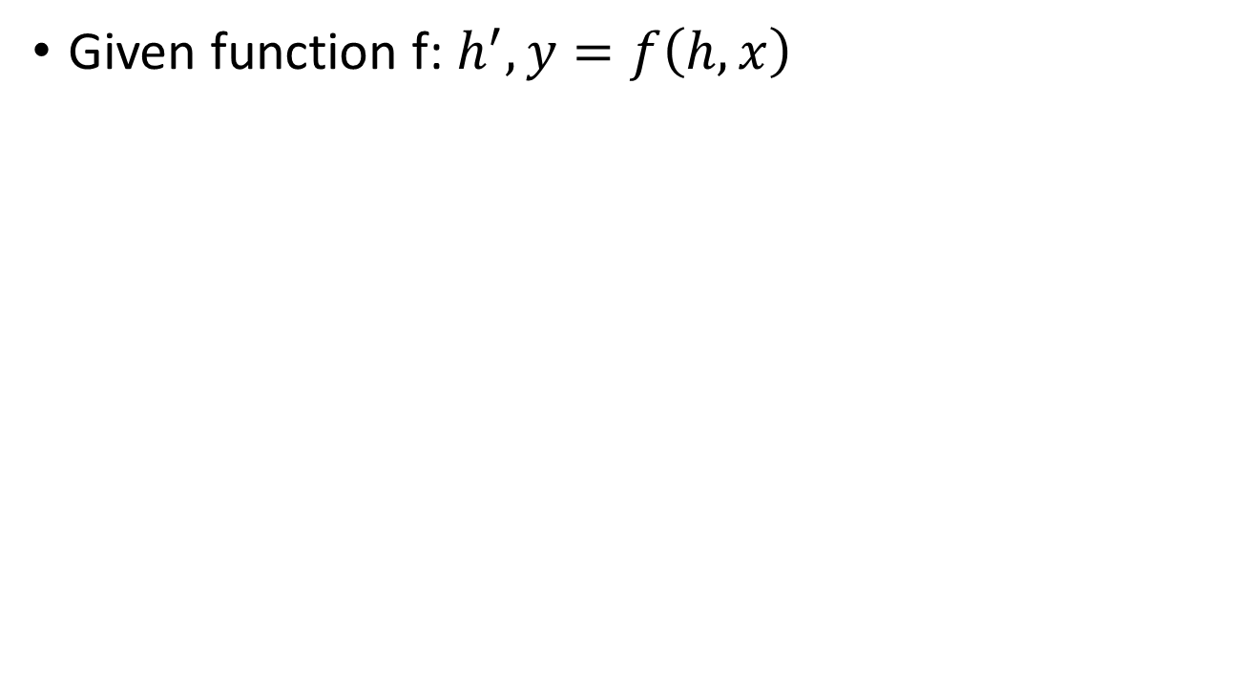
Recurrent Neural Network
h and h’ are vectors with the same dimension
Given function f: $h^{′},y=f\left(h,x\right)$
y¹
y²
y³
h⁰
f
h¹
f
h²
f
h³
……
x¹
x²
x³
No matter how long the input/output sequence is, we only need one function f

Slide 5
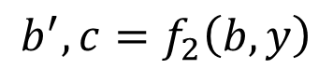
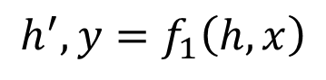
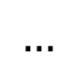
Deep RNN
$$h^{′},y=f_{1}\left(h,x\right)$$
$$b^{′},c=f_{2}\left(b,y\right)$$
$$…$$
…
…
…
c¹
c²
c³
b⁰
f₂
b¹
f₂
b²
f₂
b³
……
y¹
y²
y³
h⁰
f₁
h¹
f₁
h²
f₁
h³
……
x¹
x²
x³

Slide 6
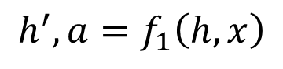
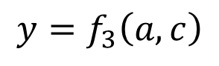
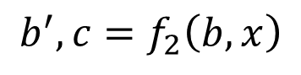
Bidirectional RNN
$$h^{′},a=f_{1}\left(h,x\right)$$
$$b^{′},c=f_{2}\left(b,x\right)$$
x¹
x²
x³
b⁰
f₂
b¹
f₂
b²
f₂
b³
c¹
c²
c³
y¹
y²
y³
$$y=f_{3}\left(a,c\right)$$
f₃
f₃
f₃
a¹
a²
a³
h⁰
f₁
h¹
f₁
h²
f₁
h³
x¹
x²
x³
Notes:
To determine yi, you have to consider a lot ……
There are more different types in the slides of HW3.

Slide 7
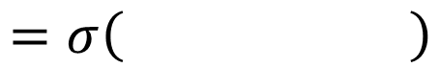
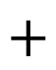
Naïve RNN
Given function f: $h^{′},y=f\left(h,x\right)$
y
h'
W^{h}
h
W^{i}
x
$$+$$
$$=σ\left( \right)$$
h
f
h'
y
Wº
h'
$$=σ\left( \right)$$
x
softmax
Ignore bias here

Slide 8
LSTM
y^{t}
LSTM
c^{t}
y^{t}
c^{t-1}
Naive
h^{t}
h^{t}
h^{t-1}
h^{t-1}
x^{t}
x^{t}
c changes slowly
c^{t} is c^{t-1} added by something
h changes faster
h^{t} and h^{t-1} can be very different

Slide 9
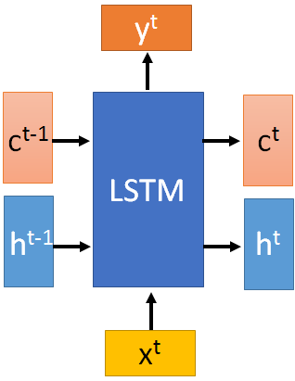


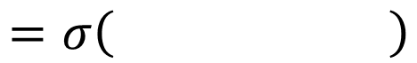
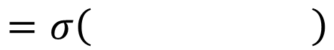
x^{t}
z
W
$$=tanh\left( \right)$$
h^{t-1}
c^{t-1}
x^{t}
z^{i}
W^{i}
$$=σ\left( \right)$$
h^{t-1}
Input
gate
x^{t}
z^{f}
W^{f}
$$=σ\left( \right)$$
h^{t-1}
z^{f}
z^{i}
z
zº
forget
gate
x^{t}
zº
Wº
$$=σ\left( \right)$$
h^{t-1}
x^{t}
h^{t-1}
output
gate
Notes:
Identiy
C is vector

Slide 10
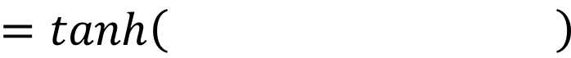
x^{t}
z
W
h^{t-1}
$$=tanh\left( \right)$$
c^{t-1}
c^{t-1}
diagonal
“peephole”
zº
z^{f}
z^{i}
obtained by the same way
z^{f}
z^{i}
z
zº
h^{t-1}
x^{t}
Notes:
Identiy
C is vector

Slide 11

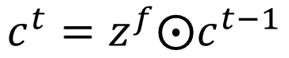

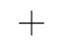

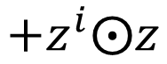
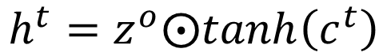
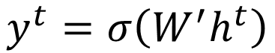
y^{t}
c^{t-1}
c^{t}
$$⨀$$
$$＋$$
$$⨀$$
$$c^{t}=z^{f}⨀c^{t−1}$$
$$+z^{i}⨀z$$
$$⨀$$
$$h^{t}=z^{o}⨀tanh\left(c^{t}\right)$$
z^{f}
z^{i}
z
zº
$$y^{t}=σ\left(W^{′}h^{t}\right)$$
h^{t-1}
x^{t}
h^{t}
Notes:
Identiy
C is vector

Slide 12




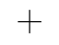

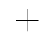

LSTM
y^{t}
y^{t+1}
c^{t-1}
c^{t}
c^{t+1}
$$⨀$$
$$＋$$
$$⨀$$
$$⨀$$
$$＋$$
$$⨀$$
$$⨀$$
$$⨀$$
z^{f}
z^{i}
z
zº
z^{f}
z^{i}
z
zº
h^{t+1}
h^{t-1}
x^{t}
h^{t}
x^{t+1}
Notes:
https://arxiv.org/pdf/1412.3555.pdf
Identiy
C is vector

Slide 13
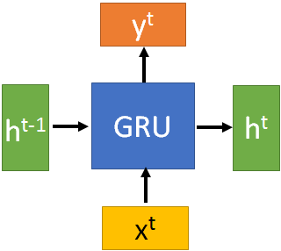
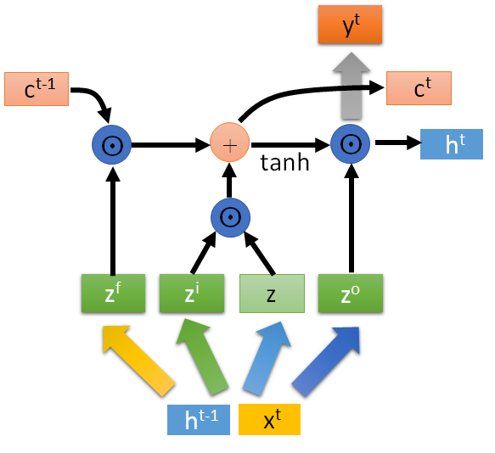
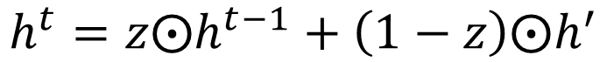
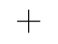



GRU
$$h^{t}=z⨀h^{t−1}+\left(1−z\right)⨀h^{′}$$
y^{t}
h^{t-1}
$$⨀$$
$$＋$$
h^{t}
$$⨀$$
1-
$$⨀$$
reset
update
r
z
h'
h^{t-1}
x^{t}
x^{t}
Notes:
It combines the forget and input gates into a single “update gate.” It also merges the cell state and hidden state, and makes some other changes.
The update gate in GRU is corresponding to the forget gate in LSTM.
In GRU, reset gate does not control the amount of the candidate hidden state independently, it shares some information of update gate and thus has access to important temporal information for phoneme segmentation\cite{chung2014empirical}.

Slide 14
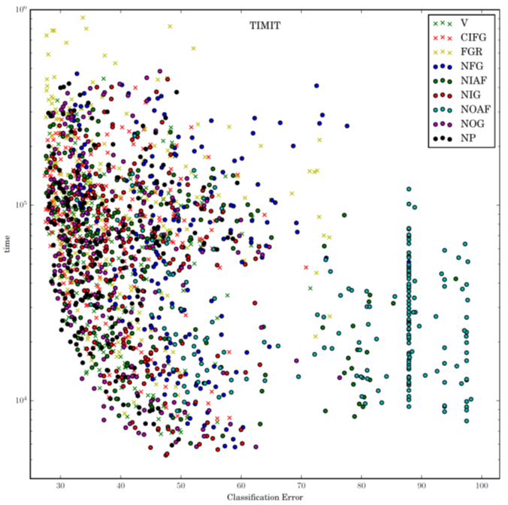
LSTM: A Search Space Odyssey
Notes:
1. No Input Gate (NIG) 2. No Forget Gate (NFG) 3. No Output Gate (NOG) 4. No Input Activation Function (NIAF) 5. No Output Activation Function (NOAF) 6. No Peepholes (NP) 7. Coupled Input and Forget Gate (CIFG) 8. Full Gate Recurrence (FGR)

Slide 15
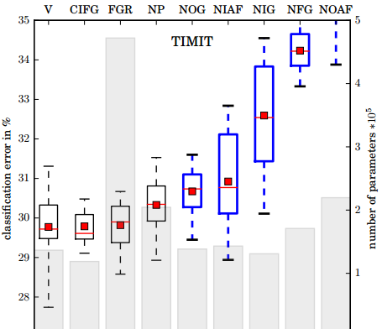
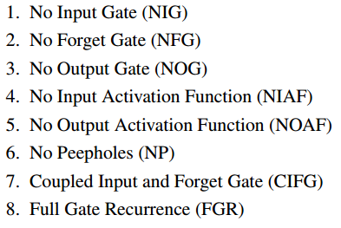
LSTM: A Search Space Odyssey
Standard LSTM works well
Simply LSTM: coupling input and forget gate, removing peephole
Forget gate is critical for performance
Output gate activation function is critical
Notes:
There are more analysis about the interation between the paramters.
Boxes show the range between the 25th and the 75th percentile of the data, while the whiskers indicate the whole range. The red dot represents the mean and the red line the median of the data. The boxes of variants that differ significantly from the vanilla LSTM are shown in blue with thick lines.

Slide 16
Sequence Generation

Slide 17
Generation
你
我
他
是
很
x:
0
1
0
0
0
……
0
y:
0
0
0
0.7
0.3
……
0
Sentences are composed of characters/words
Generating a character/word at each time by RNN
y
Distribution over the token
(sampling from the distribution to generate a token)
h
f
h'
x
The token generated at the last time step.
(represented by 1-of-N encoding)

Slide 18



Generation
y¹: P(w|<BOS>)
y²: P(w|<BOS>,床)
y³: P(w|<BOS>,床,前)
Sentences are composed of characters/words
Generating a character/word at each time by RNN
床
前
明
sample, argmax
$$\sim$$
$$\sim$$
$$\sim$$
Until <EOS> is generated
y¹
y²
y³
h⁰
f
h¹
f
h²
f
h³
……
x¹
x²
x³
<BOS>
床
前

Slide 19
Generation
: minimizing cross-entropy
Training data: 春眠不觉晓
Training
春
眠
不
y¹
y²
y³
h⁰
f
h¹
f
h²
f
h³
……
x¹
x²
x³
<BOS>
春
眠

Slide 20
Generation
Consider as a sentence
blue
red
yellow
……
gray
Train a RNN based on the “sentences”
Images are composed of pixels
Generating a pixel at each time by RNN
red
blue
green
$$\sim$$
$$\sim$$
$$\sim$$
y¹
y²
y³
h⁰
f
h¹
f
h²
f
h³
……
x¹
x²
x³
<BOS>
red
blue

Slide 21
Conditional Sequence Generation

Slide 22



Conditional Generation
We don’t want to simply generate some random sentences.
Generate sentences based on conditions:
Caption Generation
Given condition:
“A young girl is dancing.”
Chat-bot
“Hello”
“Hello. Nice to see you.”
Given condition:

Slide 23
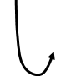

Conditional Generation
Represent the input condition as a vector, and consider the vector as the input of RNN generator
Image Caption Generation
A
woman
. (period)
A vector
<BOS>
CNN
……
Input image

Slide 24
Conditional Generation
Sequence-to-sequence learning
Represent the input condition as a vector, and consider the vector as the input of RNN generator
E.g. Machine translation / Chat-bot
machine
learning
. (period)
Information of the whole sentences
机
器
学
习
Encoder
Jointly train
Decoder

Slide 25

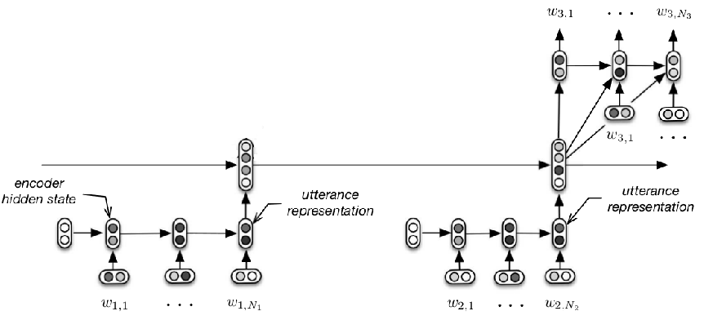
Conditional Generation
M: Hi
M: Hello
Need to consider longer context during chatting
U: Hi
M: Hi
M: Hello
U: Hi
Serban, Iulian V., Alessandro Sordoni, Yoshua Bengio, Aaron Courville, and Joelle Pineau, 2015 "Building End-To-End Dialogue Systems Using Generative Hierarchical Neural Network Models.

Slide 26
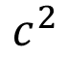
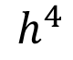
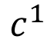
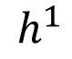
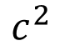
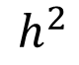
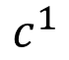
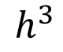
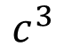
Dynamic Conditional Generation
$$c^{1}$$
$$c^{2}$$
machine
learning
. (period)
$$h^{1}$$
$$h^{2}$$
$$h^{3}$$
$$h^{4}$$
机
器
学
习
$$c^{1}$$
$$c^{2}$$
$$c^{3}$$
Encoder
Decoder

Slide 27
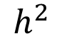
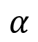
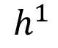
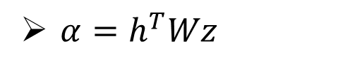
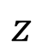
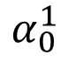
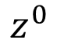
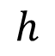
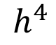
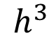
Machine Translation
$$α$$
Jointly learned with other part of the network
match
Attention-based model
$$h$$
$$z$$
$$α_{0}^{1}$$
match
What is ?
match
$$z^{0}$$
Design by yourself
Cosine similarity of z and h
$$h^{1}$$
$$h^{2}$$
$$h^{3}$$
$$h^{4}$$
Small NN whose input is z and h, output a scalar
机
器
学
习
$α=h^{T}Wz$

Slide 28
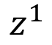
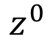












Machine Translation
Attention-based model
machine
$$c^{0}$$
0.5
$${\hat{α}}_{0}^{1}$$
0.5
$${\hat{α}}_{0}^{2}$$
0.0
$${\hat{α}}_{0}^{3}$$
0.0
$${\hat{α}}_{0}^{4}$$
$$z^{0}$$
$$z^{1}$$
softmax
$$α_{0}^{1}$$
$$α_{0}^{2}$$
$$α_{0}^{3}$$
$$α_{0}^{4}$$
$$c^{0}$$
Decoder input
$$h^{1}$$
$$h^{2}$$
$$h^{3}$$
$$h^{4}$$
$$c^{0}=\sum{{\hat{α}}_{0}^{i}h^{i}}$$
机
器
学
习
$$=0.5h^{1}+0.5h^{2}$$

Slide 29

Machine Translation
Attention-based model
machine
$$α_{1}^{1}$$
match
$$z^{0}$$
$$z^{1}$$
$$c^{0}$$
$$h^{1}$$
$$h^{2}$$
$$h^{3}$$
$$h^{4}$$
机
器
学
习

Slide 30













Machine Translation
Attention-based model
machine
learning
$$c^{1}$$
0.0
$${\hat{α}}_{1}^{1}$$
0.0
$${\hat{α}}_{1}^{2}$$
0.5
$${\hat{α}}_{1}^{3}$$
0.5
$${\hat{α}}_{1}^{4}$$
$$z^{0}$$
$$z^{1}$$
$$z^{2}$$
softmax
$$α_{1}^{1}$$
$$α_{1}^{2}$$
$$α_{1}^{3}$$
$$α_{1}^{4}$$
$$c^{0}$$
$$c^{1}$$
$$h^{1}$$
$$h^{2}$$
$$h^{3}$$
$$h^{4}$$
$$c^{1}=\sum{{\hat{α}}_{1}^{i}h^{i}}$$
机
器
学
习
$$=0.5h^{3}+0.5h^{4}$$

Slide 31

Machine Translation
Attention-based model
machine
learning
……
$$α_{2}^{1}$$
……
match
$$z^{0}$$
$$z^{1}$$
$$z^{2}$$
$$c^{0}$$
$$c^{1}$$
……
$$h^{1}$$
$$h^{2}$$
$$h^{3}$$
$$h^{4}$$
The same process repeat until generating
机
器
学
习
<EOS>

Slide 32


Image Caption Generation
A vector for each region
match
$$z^{0}$$
0.7
CNN
filter
filter
filter
filter
filter
filter
filter
filter
filter
filter
filter
filter

Slide 33

Image Caption Generation
Word 1
A vector for each region
$$z^{0}$$
$$z^{1}$$
CNN
filter
filter
filter
weighted sum
filter
filter
filter
0.7
0.1
0.1
0.1
0.0
0.0
filter
filter
filter
filter
filter
filter

Slide 34

Image Caption Generation
Word 1
Word 2
A vector for each region
$$z^{0}$$
$$z^{1}$$
$$z^{2}$$
weighted sum
CNN
filter
filter
filter
filter
filter
filter
0.0
0.8
0.2
0.0
0.0
0.0
filter
filter
filter
filter
filter
filter

Slide 35
Image Caption Generation
Kelvin Xu, Jimmy Ba, Ryan Kiros, Kyunghyun Cho, Aaron Courville, Ruslan Salakhutdinov, Richard Zemel, Yoshua Bengio, “Show, Attend and Tell: Neural Image Caption Generation with Visual Attention”, ICML, 2015

Slide 36
Image Caption Generation
Kelvin Xu, Jimmy Ba, Ryan Kiros, Kyunghyun Cho, Aaron Courville, Ruslan Salakhutdinov, Richard Zemel, Yoshua Bengio, “Show, Attend and Tell: Neural Image Caption Generation with Visual Attention”, ICML, 2015

Slide 37



Li Yao, Atousa Torabi, Kyunghyun Cho, Nicolas Ballas, Christopher Pal, Hugo Larochelle, Aaron Courville, “Describing Videos by Exploiting Temporal Structure”, ICCV, 2015

Slide 38

Mismatch between Train and Test
Reference:
Training
A
B
B
$$C=\sum_{t}{C_{t}}$$
A
A
A
B
B
B
Minimizing cross-entropy of each component
<BOS>
A
: condition
B

Slide 39
Mismatch between Train and Test
Generation
B
A
A
We do not know the reference
A
A
A
Testing: The inputs are the outputs of the last time step.
B
B
B
Training: The inputs are reference.
<BOS>
A
B

Slide 40



B
A
B
A
A
A
B
B
A
B
A
B
One step wrong
A
B
B
A
B
A
A
A
B
B
A
B
A
B
May be totally wrong
Never explore ……
A
B
一步错，步步错

Slide 41

Scheduled Sampling
A
Reference
B
B
A
A
A
A
B
B
B
A
B
from model
from model
A
From reference
From reference
B

Slide 42










Reinforcement learning?
Start with observation $s_{1}$
Observation $s_{2}$
Observation $s_{3}$
Obtain reward $r_{1}=0$
Obtain reward $r_{2}=5$
Action $a_{1}$: “right”
Action $a_{2}$: “fire”
(kill an alien)

Slide 43



Reinforcement learning?
$$reward:$$
R(“BAA”, reference)
$r=0$
$r=0$
Action taken
B
A
A
A
A
A
Actions set
B
B
B
<BOS>
A
observation
B
Marc'Aurelio Ranzato, Sumit Chopra, Michael Auli, Wojciech Zaremba, “Sequence Level Training with Recurrent Neural Networks”, ICLR, 2016
The action we take influence the observation in the next step

Slide 44
The End!

